Slide 1
Cafe Crew App Usability Study
07/07/2022
Anagha Manoj UX Design

Slide 2
Table of Contents
Section 1 Study Details
Section 2 Themes
Section 3 Insights & Recommendations

Slide 3
Study Details

Slide 4
Project Background
We are creating a Cafe ordering app - Cafe Crew - to help people place, pick up and order efficiently for themselves or as a group, so that they can skip in - store lines and can go through the whole process hassle-free.
We noticed that our competitors offer dedicated mobile apps for their customers to order through, and they have been very successful. We want to create a product that can compete in the market, improve sales, and increase customer satisfaction.

Slide 5
Study Details
Research Questions
Participants
Methodology
How long does it take a customer to make an order?
What can we learn from observing how users interact with the app in terms of ease of use?
Are there any additional difficulties users face while interacting with the product?
Are there any parts of the process which could have been more concise or simpler?
What can we learn from the steps users take to order as a group, and on their own?
6 participants
Two males, two females, and one nonbinary induvidual between the ages of 20 and 75. One participant is a person with visual impairment. Another participant has hearing impairment.One participant is a person who is not fluent in english.
Participants between the ages of 20 -75 who reside in metropolitan and suburb areas. Participants order out at least once a week.
Unmoderated usability study
Location: India, remote (each participant went through usability study in their own home)
Six participants, each completing their study on their own
Each session will last about 45 mins and will include an introduction, a list of tasks to perform in a low fidelity prototype, and a short questionnaire.

Slide 6
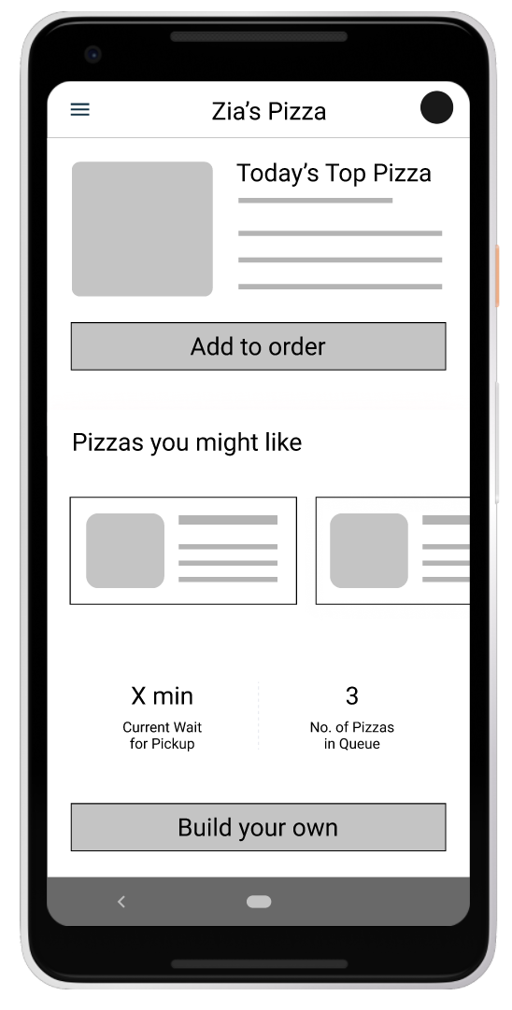
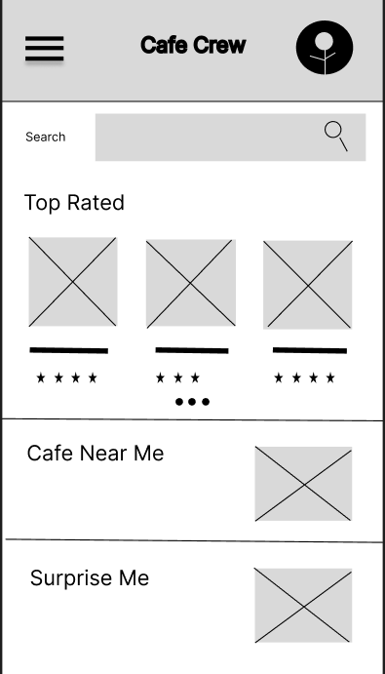
Prototype Tested
The low-fidelity app prototype for Zia’s Pizza was tested and can be viewed link.

Slide 7
Themes

Slide 8
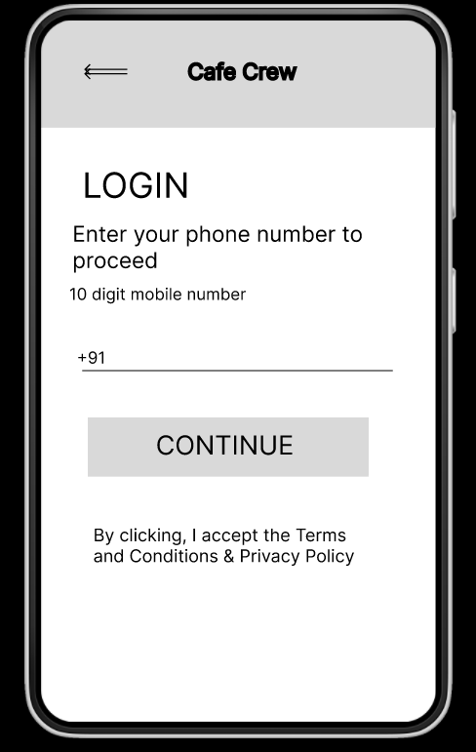
People want more of an intuitive experience while ordering from an app
Supporting evidence from the usability study.
It was observed that 2 out of 5 participants could not easily navigate through the app.
4 out of 7 total participants expressed a desire to save favourites for easy re-ordering
It is observed that users benefit from more images being present to assist buyers in their choices. Also, AT’s help users in their experience.
“I can’t read all this text and figure out which will be the right choice for me!”
— Michael, a recently immigrated student who frequently orders from cafes
a

Slide 9
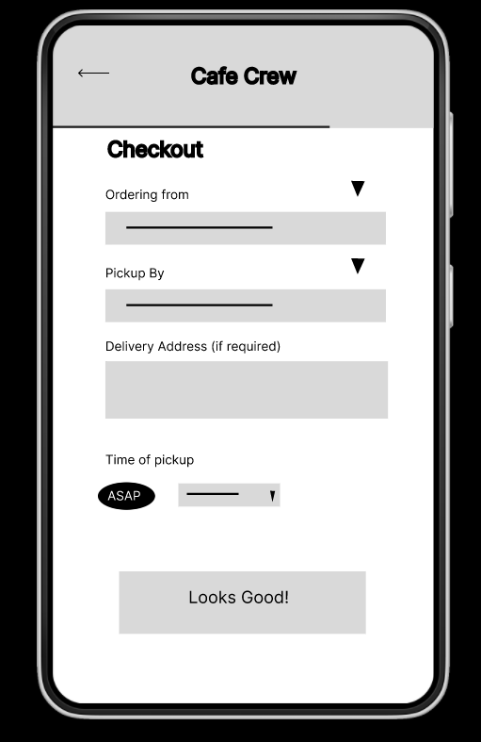
People want Group ordering options
Supporting evidence from the usability study.
4 out of 7 total participants said they wanted the ability to order for friends, family or colleagues from the app
3 of those participants noted that they would like an option to be able to send the menu so the others can view the options and make a choice.
“I order take-out for my family often.It would make things so easy if I could do so from the app”
— Mira, A student at university
a

Slide 10
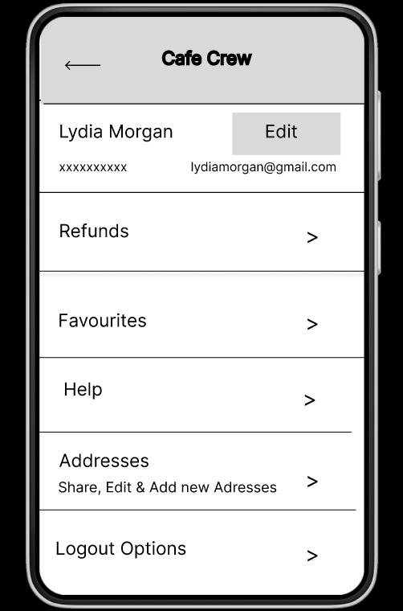
People want Language preference and Address to be taken when user logins
Supporting evidence from the usability study.
4 out of 5 total participants said they would prefer that language preferences be asked when they login since searching for settings is cumbersome
All the participants said they want the address to be taken when they log in either through GPS or otherwise since it is easier that way
“It is not easy to navigate through the app to find language settings when you have no clue what you are reading.”
— Ky Lim, non native english speaker
a

Slide 11
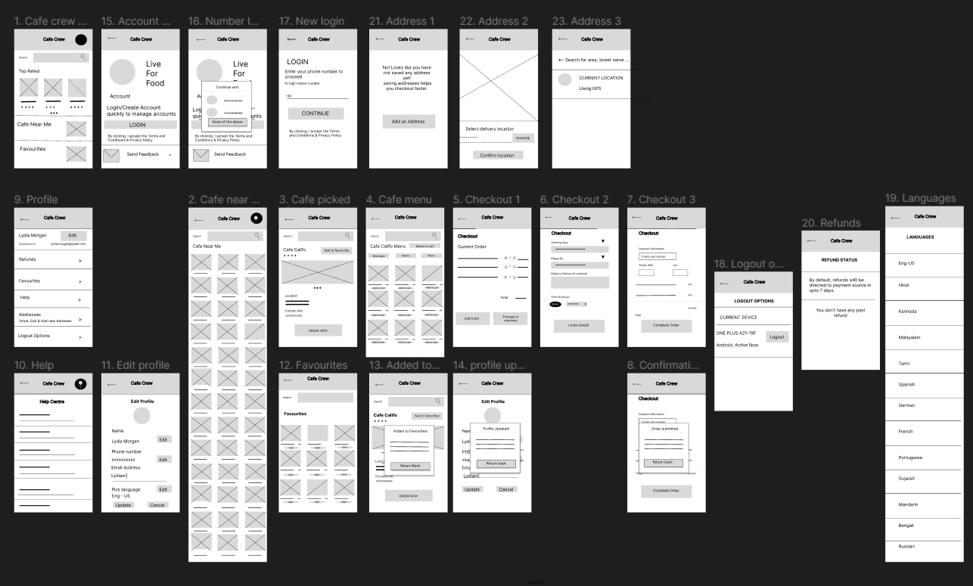
Brief review of previous presentation information. I had created wireframes earlier in the ideation phase. Some of them have been updated.

Slide 12
Insights & Recommendations

Slide 13
Research insights
Language preference and Address to be taken when user logins
Less text content and more images with alt text
Group ordering feature
In general, group ordering is a helpful feature that allows multiple orders to be collected and done smoothly and efficiently.
Users should be able to pick their preferred language and address when logging in to the app instead of searching for it later for a better user experience.
Having a lot of unnecessary text is cumbersome. It is best to put only relevant information and images with alt-texts to help make the experience pleasant.

Slide 14
Recommendations
The Group Ordering feature should be made more intuitive and easy for users to use.
We need to make it easier for users to find the pages when they need to edit their preferred language or address. Also, using GPS to pinpoint the location of the user when entering the app homepage itself reduces effort.
We have to reduce the texts other than what is necessary for relaying information and add more images with alt texts to support and guide users of all spectrums.
Also, making use of ATs could help improve the client experience significantly.
.

Slide 15
Next Steps
Complete the wireframes
Conduct more usability studies
Refine the designs

Slide 16
Thank you!

